Slide 1
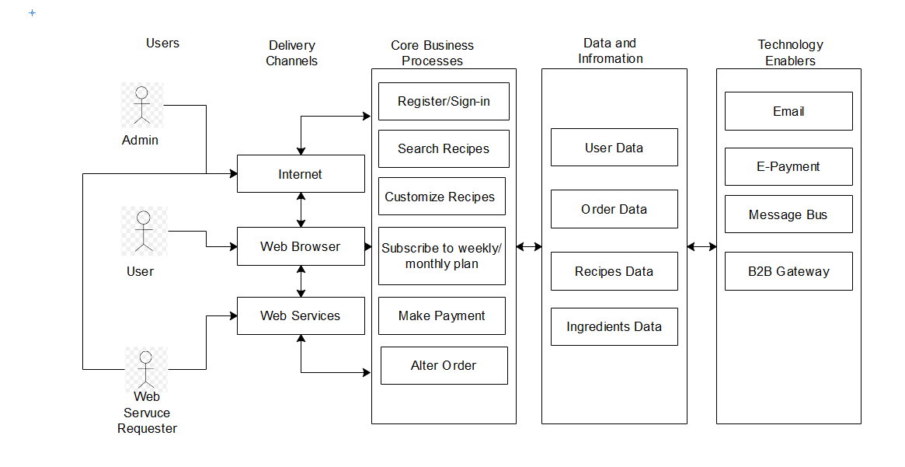
MyPersonalChef Web Application Architecture Type: Application Architecture View: Logical View Style: Layered Architecture Pattern
Architecture Diagram

Slide 2
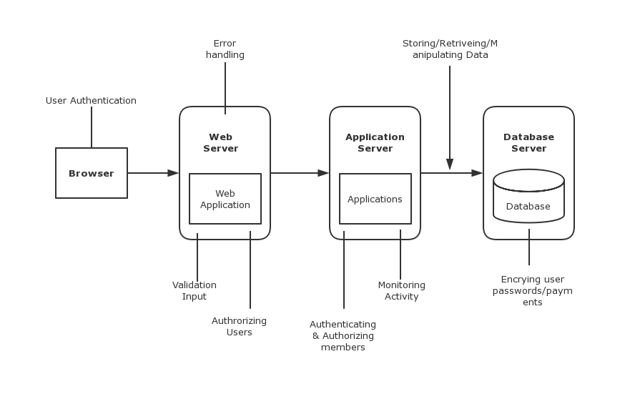
MyPersonalChef
Type: Application Architecture
View: Process View
Style: Layered Architecture Pattern
Architecture Diagram

Slide 3
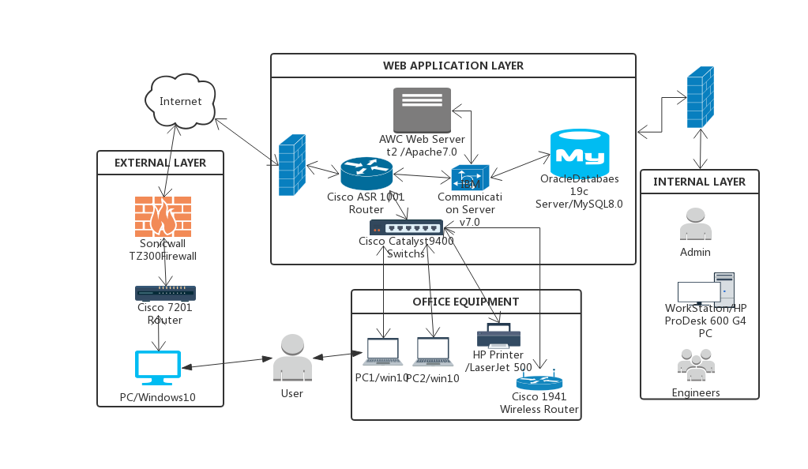
MyPersonalChef Web Application Architecture Type: Application Architecture View: Physical View Style: Layered Architecture Pattern
Cisco Meraki MX100 Firewall
Cisco Meraki MX100 Firewall

